Slide 1
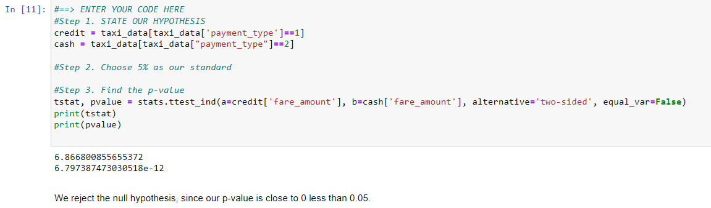
Title
Course 4 Automatidata project
Project Overview
The purpose of this project is to demostrate knowledge of how to prepare, create, and analyze A/B tests. Your A/B test results should aim to find ways to generate more revenue for taxi cab drivers.
We conclude that the hypothesis test that there is a difference in the average fare amount between customers who use credit cards and customers who use cash to generate more revenue. This project requires an assumption that passengers were forced to pay one way or the other, and that once informed of this requirement, they always complied with it. The data was not collected this way; so, an assumption had to be made to randomly group data entries to perform an A/B test. This dataset does not account for other likely explanations. For example, riders might not carry lots of cash, so it's easier to pay for longer/farther trips with a credit card. In other words, it's far more likely that fare amount determines payment type, rather than vice versa.
Refer from the Key Insights
NOTE: For the TikTok and Wave cases,
your Key insights, Details and Steps depends on the
Research task. (Refer to exemplar for each cases)

